Slide 1

GREENHOUSE MONITORING AND CONTROL SYSTEM
GRADUATE: Alexandru Florin OLIVA
SUPERVISOR: L. ENG. Radu MIRON, PHD

Slide 2
Content
Introduction
Application objectives
Bibliographic research
Hardware architecture
Software architecture
Implementation and detailed design
Testing and validation
Conclusions

Slide 3
Introduction
Indoor growing and greenhouses need additional observation and permanent presence of the owners
People tend to neglect the necessary resources for their plants
Climate factors required for an optimal growth aren’t generally known

Slide 4
Application Objectives
Creating an adaptable web application to fit the requirements
Monitor the climate factors (light, air temperature, air humidity, and soil moisture) on data grid views and graphics
Remotely control the necessary resources (compact fluorescent lamp, water pump)

Slide 5
Bibliographic research
Internet of Things
Big Data
Cloud Computing

Slide 6
Hardware architecture
Monitoring system
Control system
Client-Server-Client

Slide 7
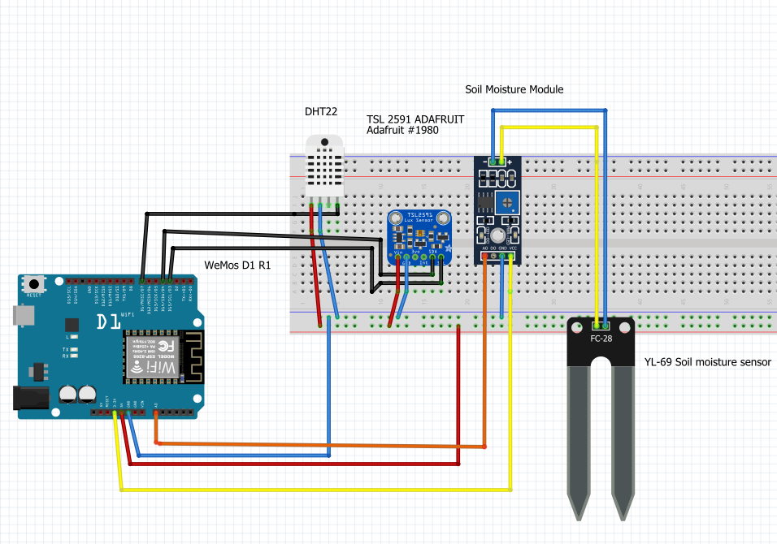
Monitoring system

Slide 8
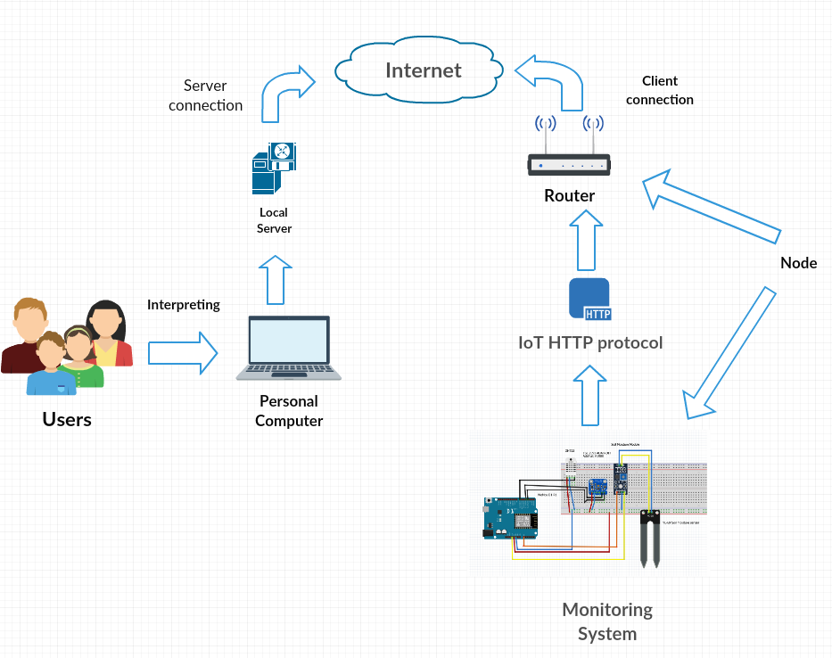
Hardware deployment diagram for the monitoring system

Slide 9
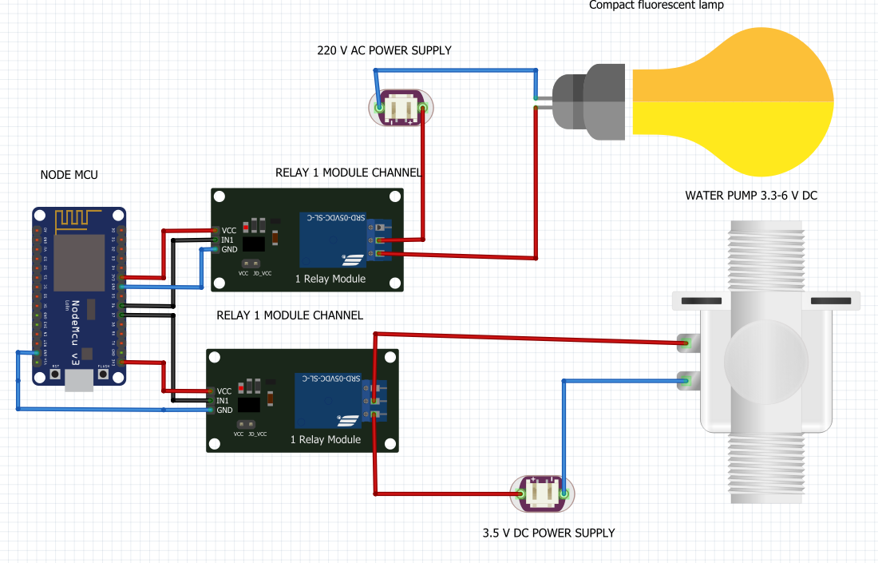
Control system

Slide 10
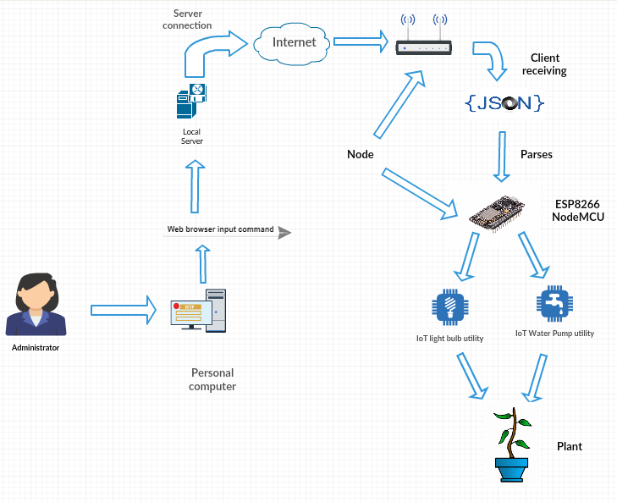
Hardware deployment diagram for the control system

Slide 11
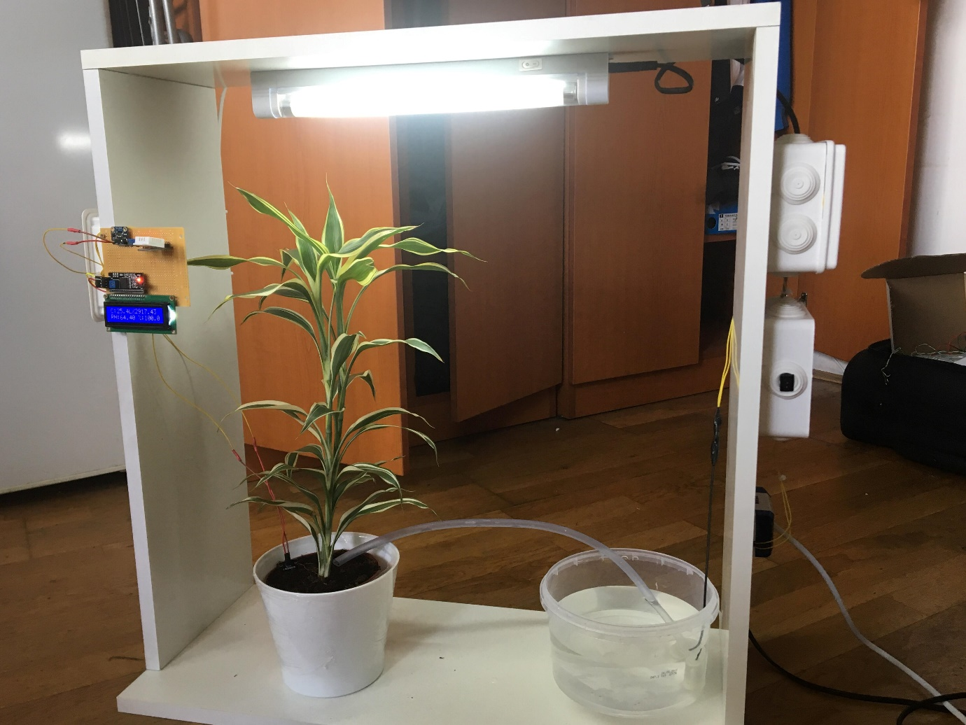
Implementation of the physical framework

Slide 12
Software architecture
Technologies used:
PHP
LARAVEL Framework
MVC pattern
JQUERY AJAX
Bootstrap
Highcharts JavaScript
C++
XAMPP server

Slide 13
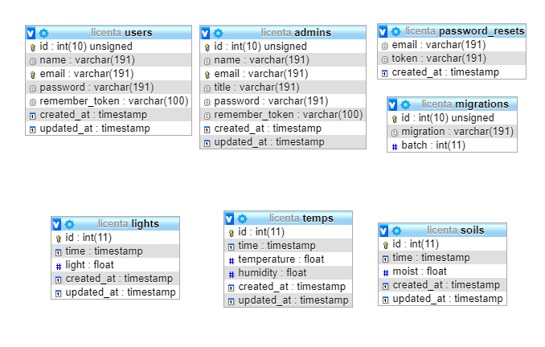
Implementation and detailed design
Database diagram:

Slide 14
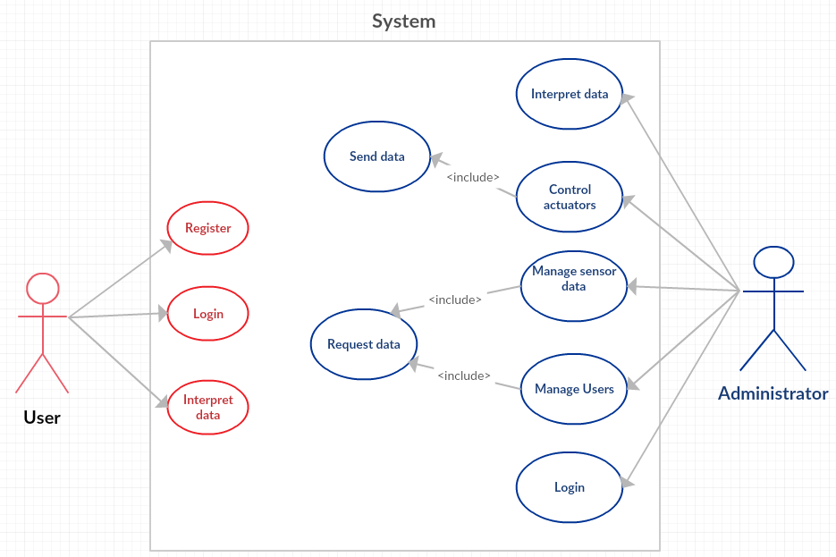
Use case diagram

Slide 15
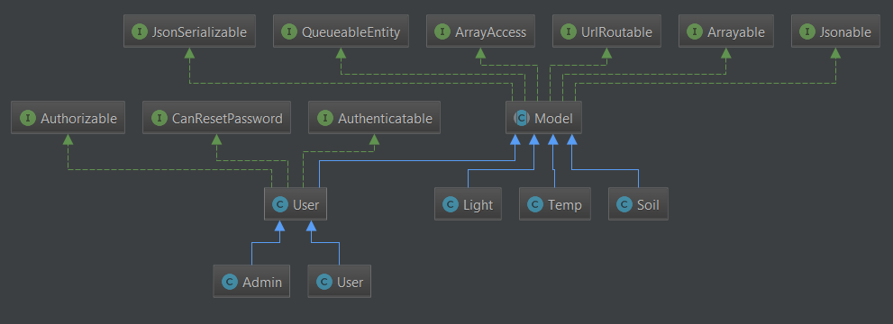
UML class diagram for Models

Slide 16
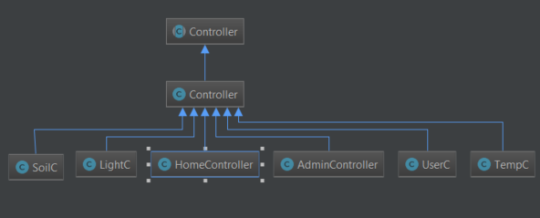
UML class diagram for Controllers

Slide 17
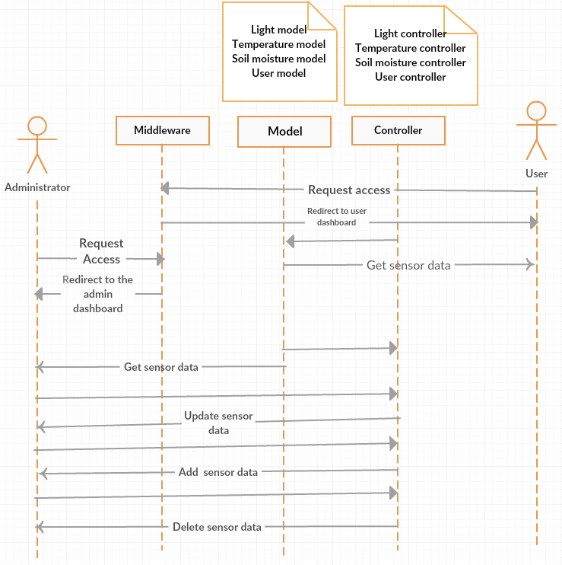
Sequence Diagram

Slide 18
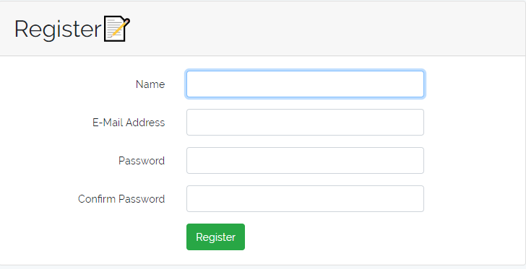
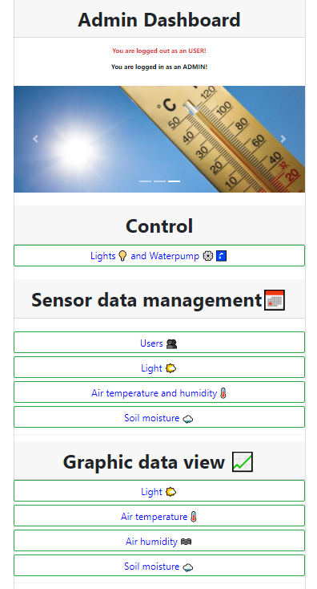
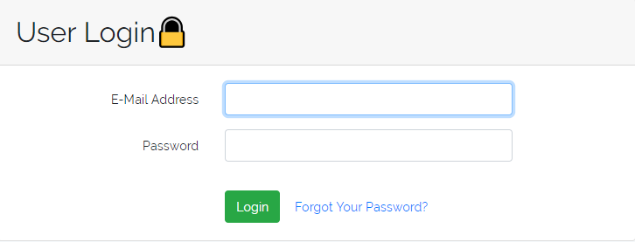
Testing and Validation

Slide 19
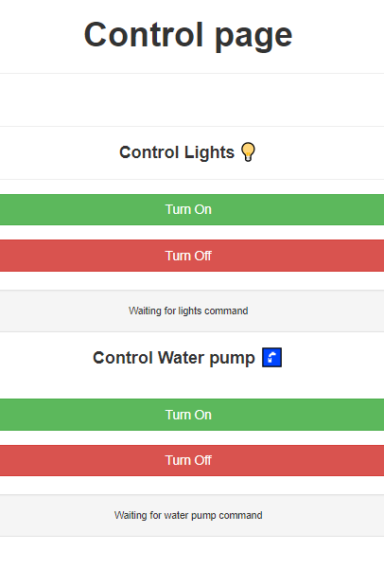
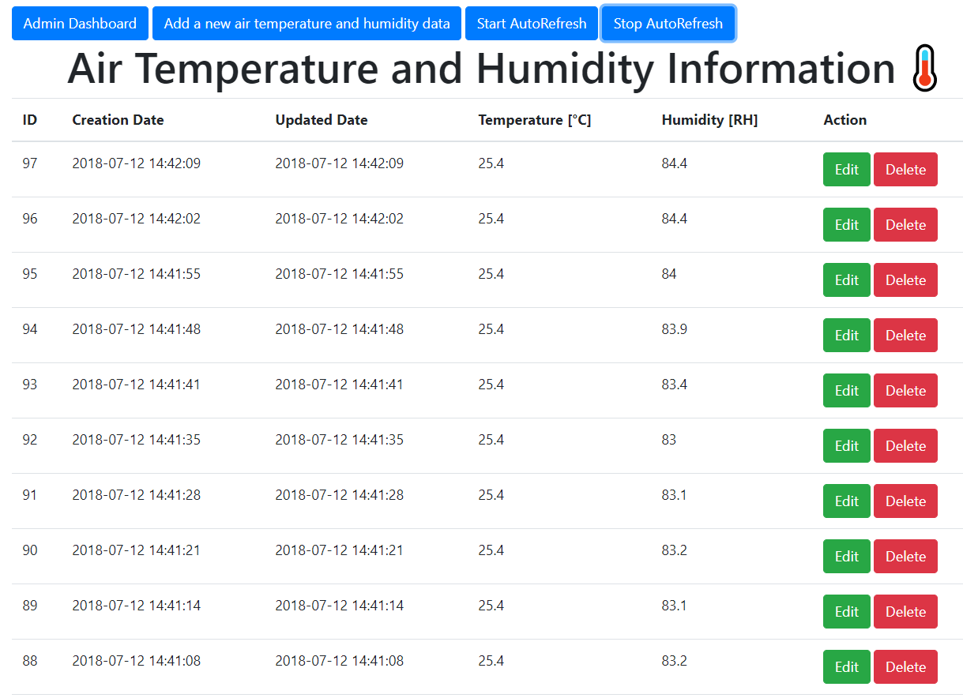
Testing and Validation

Slide 20
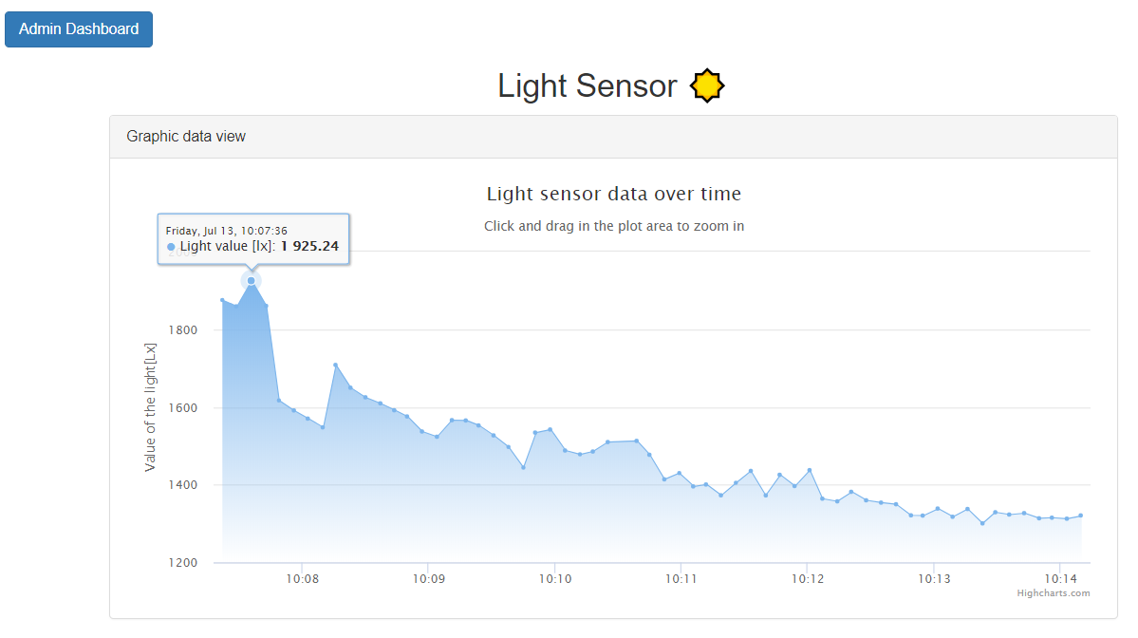
Testing and Validation

Slide 21
Conclusions
Obtained results
Created a web application which can monitor remotely the collected data form the sensors and manage it.
Remotely controlled the water supply and the compact fluorescent lamp
Enhanced environment for indoor growing and development of greenhouses
Future development
Host the web application on a public domain
Implementing a safety alarm for water flood
Adding sensors for oxygen and carbon dioxide

Slide 22
Thank you for your attention!

